Slide 1
SYSTEM SOFTWARE

Slide 2
UNIT-I
Introduction
System Software and Machine Architecture
The Simplified Instructional Computer (SIC)
Traditional (CISC) Machines
RISC Machines

Slide 3
SYSTEM SOFTWARE
System software consists of a variety of programs that support the operation of a computer

Slide 4
SYSTEM SOFTWARE
System software is computer software designed to operate and control the computer hardware and to provide a platform for running application software.

Slide 5

SYSTEM SOFTWARE
The role of Systems Software –interface between users, application software and hardware

Slide 6
SYSTEM SOFTWARE
System software is a bridge between application software and Hardware.

Slide 7
SYSTEM SOFTWARE
APPLICATION SOFTWARE
SYSTEM
SOFTWARE
HARDWARE

Slide 8
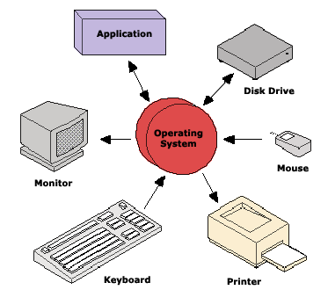
SYSTEM SOFTWARE

Slide 9
APPLICATION SOFTWARE
Application software, also known as an application.
Application is computer software designed to help the user to perform specific tasks. Examples include enterprise software, accounting software, and graphics software and media players.

Slide 10
Difference between System Software and Application Software
System Software | Application Software
System software consists of a variety of programs that support the operation of a computer. for example operating system, assembler, loader, linker, and microprocessor and text editor. | Application software is a set of one or more programs, designed to solve a specific problem. for example employee management system ,bank management system and media player.
System software is system dependent | application software is not a system dependent
system software works directly with the hardware | application software works directly with the system software.
system software are written in machine or assembly languages. | variety of programming languages can be used to write application software, such as C , Java and .NET

Slide 11
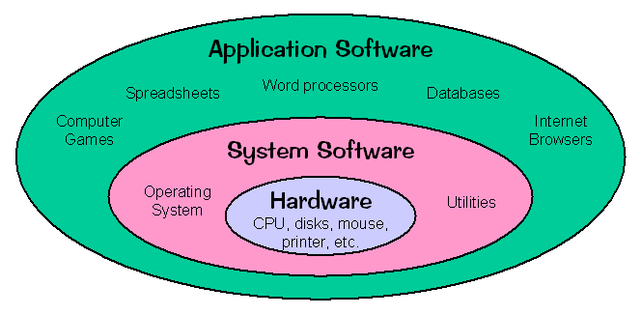
Difference between System Software and Application Software

Slide 12
System software functions:
1.Supports the development of other application
software. 2.supports the execution of other application
software 3.Monitors the effective use of various hardware
resources, such as CPU, memory, peripherals,
etc.

Slide 13
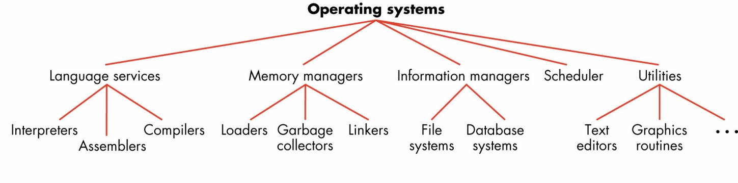
Types of System Software

Slide 14
Types of System Software
Assembler
Linker
Loader
Macro processor
Text editor
Debugger
File System
Database

Slide 15
Assembler
Assembly Level language Machine level language
program program
Assembler

Slide 16
Linker
Object File 1
Executable File
Object File 2
Object File 3

Slide 17
Loader
Secondary memory
Main memory
Loader

Slide 18
Macro processor
Macro processor
Source Code
(with macro)
Expanded Source Code

Slide 19
Text editor
A text editor is a type of program used for editing plain text files.

Slide 20
Debugger
A debugger or debugging tool is a computer program that is used to test and debug other programs.

Slide 21
System Software and Machine Architecture
Machine dependency of system software
Machine code
Instruction formats
Addressing mode
Registers
Machine independency of system software
Code optimization
Subprogram linking

Slide 22
System Software and Architecture
System software will be discussed:
The basic functions
Machine-dependent functions
Machine-independent functions
Design options (single-pass vs. multi-pass)
Examples of implementations

Slide 23
Simplified Instructional Computer

Slide 24
SIC and SIC/XE
The Simplified Instructional Computer is a hypothetical computer, that is used as a base to explain the operation of a real computer.
Two versions
Standard model (SIC) and an XE version (SIC/XE)
Upward compatible
Programs for SIC can run on SIC/XE

Slide 25
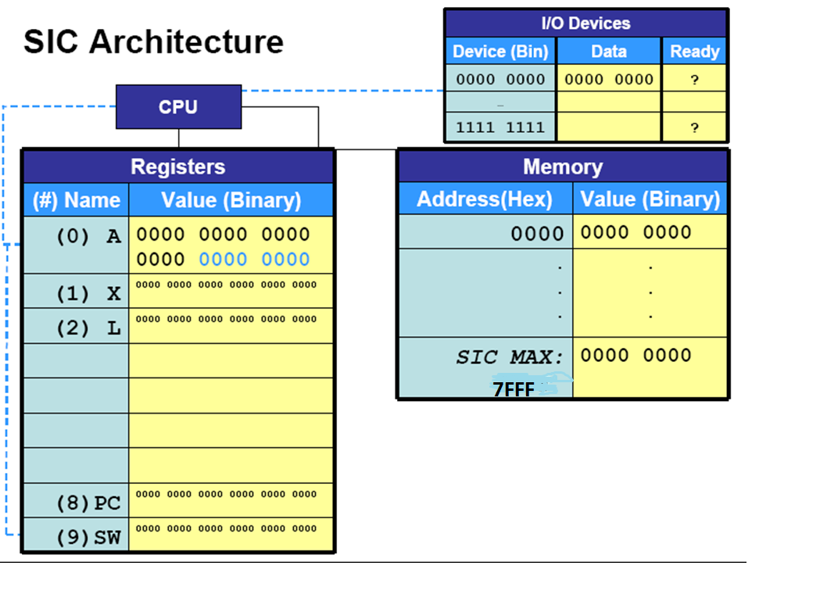

Slide 26
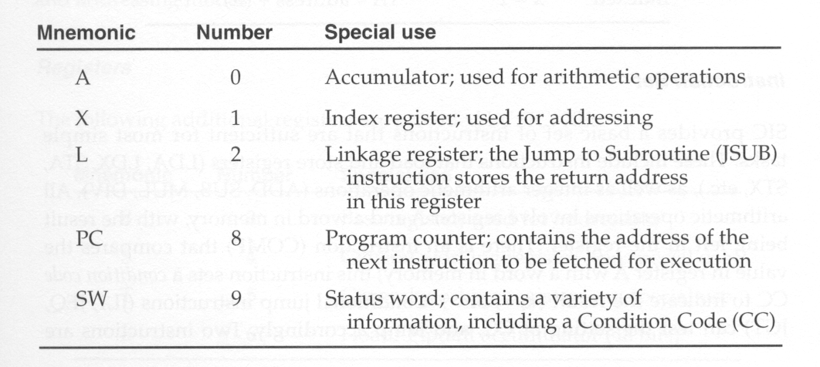
Registers
Five 24-bit registers
3-7: reserved for future use

Slide 27
Memory
A word (3 bytes, or 24 bits)
…

Slide 28
Data Formats
Integers are stored as 24-bit binary numbers;
2’s complement representation is used for negative values
No floating-point hardware

Slide 29
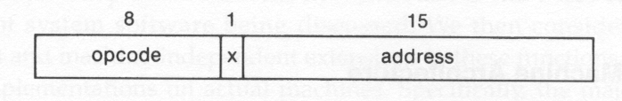
Instruction formats
24 bits
To indicate indexed-addressing mode

Slide 30
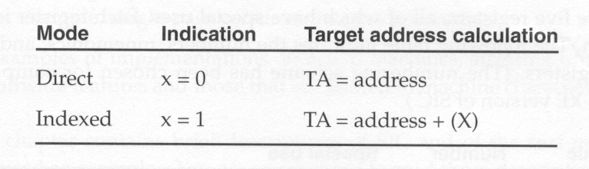
Addressing modes
( ): Contents of a register or a memory location

Slide 31
Direct Addressing
Address Statement
1000 LDA TEN
…… ……. ……
.….. ……. ……
1050 TEN WORD 10
Target Address=Address
TA=1050

Slide 32
Indexed Addressing
Address Statement
1000 LDX ZERO
LDCH STR1 , X
…… ……… …………
…… ……… ………….
1050 ZERO WORD 0
1053 STR1 BYTE C ‘ TEST’
TA=Address+[x]
TA=1053+0

Slide 33
Instruction set
Load and store registers
LDA, LDX, STA, STX
Integer arithmetic operations (involve register A and a word in memory, save result in A)
ADD, SUB, MUL, DIV
Comparison (involves register A and a word in memory, save result in the condition code (CC) of SW)
COMP
Conditional jump instructions (according to CC)
JLE, JEQ, JGT
Subroutine linkage
JSUB (jumps and places the return address in register L)
RSUB (returns to the address in L)

Slide 34
SIC Architecture
Input and output
Each IO device is assigned a unique 8-bit code
Three instructions:
Test device (TD):
Test whether the device is ready to send/receive
Test result is set in CC
Read data (RD): read one byte from the device to register A
Write data (WD): write one byte from register A to the device

Slide 35
SIC/XE Architecture

Slide 36
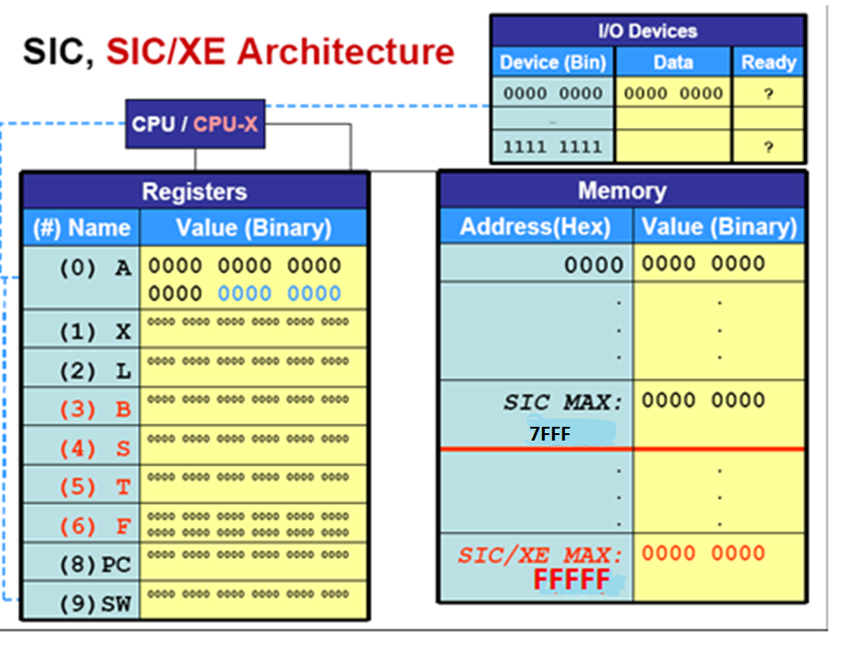

Slide 37
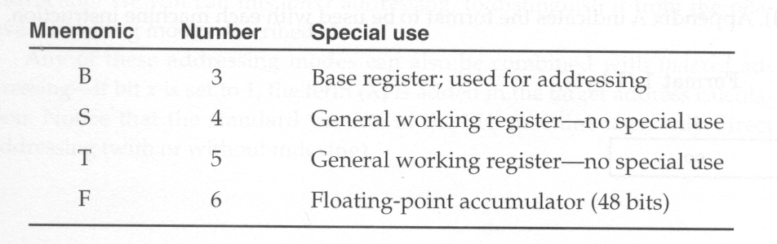
Registers
4 additional registers

Slide 38
Memory
A word (3 bytes, or 24 bits)
…

Slide 39
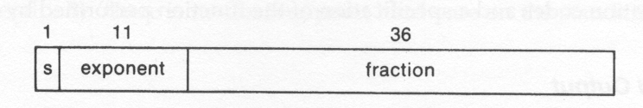
Data formats
Characters: 8-bit ASCII codes
Integers:
24-bit binary numbers
2’s complement for negative values
Floating-point numbers (48 bits)
sign bit s
exponent e: unsigned binary number between 0 and 2047value
fraction f: a value between 0 and 1
1
High-order bit must be 1 when normalized

Slide 40
Instruction formats
Format 1 (1 byte):
op {8}
Example: SIO
Format 2 (2 bytes):
op {8} | r1 {4} | r2 {4}
Example: COMPR A S
Format 3 (3 bytes):
op {6} | n | i | x | b | p | e | displacement {12}
Example: LDA #3
Format 4 (4 bytes):
op {6} | n | i | x | b | p | e | address {20}
Example: +JSUB RDREC

Slide 41
Addressing modes:
They way in which access the operand from the memory is said to be addressing mode.
An addressing mode specifies how to calculate the effective memory address of an operand by using information held in registers and/or constants contained within a machine instruction or elsewhere.

Slide 42
SIC/XE Addressing Modes
Base relative addressing mode
Program counter relative addressing mode
Direct addressing mode
Base relative indexed addressing mode
Immediate addressing mode
Indirect addressing mode

Slide 43
Base relative addressing mode
STX LENGTH
LENGTH =0033
[B]=0033
1 3 4 0 0 0
Displacement=TA-[B]
Displacement=0
TA=Displacement +[B]
TA=0+0033
Op{6} | n | i | x | b | p | e | displacement {12}
0001 00 | 1 | 1 | 0 | 1 | 0 | 0 | 0000 0000 0000

Slide 44
Program counter relative addressing mode
0000 STL RETADR
RETADR=0030
PC=0003
1 7 2 0 2 D
Displacement=TA-PC
Displacement=0030-0003=002D
TA=Displacement +PC
TA=002D+0003=0030
Op{6} | n | i | x | b | p | e | displacement {12}
0001 0 1 | 1 | 1 | 0 | 0 | 1 | 0 | 0000 0010 1101

Slide 45
Direct addressing mode
0000 LDA LENGTH
LENGTH=0033
0 3 0 0 3 3
TA=Displacement
TA=0033
Op{6} | n | i | x | b | p | e | displacement {12}
0000 0 0 | 1 | 1 | 0 | 0 | 0 | 0 | 0000 0011 0011

Slide 46
Immediate addressing mode
0000 LDA #9
0 1 0 0 0 9
Op{6} | n | i | x | b | p | e | displacement {12}
0000 0 0 | 0 | 1 | 0 | 0 | 0 | 0 | 0000 0000 1001

Slide 47
Indirect addressing mode
002A J @RETADR
RETADR=0030
PC=002D
3 E 2 0 0 3
Displacement=TA-PC
Displacement=0030-002D=0003
TA=Displacement +PC
TA=0003+002D=0030
Op{6} | n | i | x | b | p | e | displacement {12}
0011 1 1 | 1 | 0 | 0 | 0 | 1 | 0 | 0000 0000 0011

Slide 48
Base relative indexed addressing mode
STCH BUFFER,X
BUFFER=0036
[b]=0033
[x]=0000
5 7 C 0 0 3
Displacement=TA-[b]-[x]
Displacement=0036-0033-0000=0003
TA=Displacement +[b]+[x]
TA=0003+0033+0000 =0036
Op{6} | n | i | x | b | p | e | displacement {12}
0101 0 1 | 1 | 1 | 1 | 1 | 0 | 0 | 0000 0000 0011

Slide 49
Mnemonic opcode
STX 10
STL 14
LDA 00
J 3C
STCH 54

Slide 50
SIC/XE Architecture
Instruction set
Load and store registers
LDA, LDX, STA, STX, LDB, STB, …
Integer arithmetic operations
ADD, SUB, MUL, DIV, ADDF, SUBF, MULF, DIVF, ADDR, SUBR, MULR, DIVR
Comparison COMP
Conditional jump instructions (according to CC)
JLE, JEQ, JGT
Subroutine linkage
JSUB
RSUB
Supervisor call (for generating an interrupt)
SVC

Slide 51
SIC/XE Architecture
Input and output
IO device
Three instructions:
Test device (TD)
Read data (RD)
Write data (WD)
IO channels
Perform IO while CPU is executing other instructions
Three instructions:
SIO: start the operation of IO channel
TIO: test the operation of IO channel
HIO: halt the operation of IO channel

Slide 52
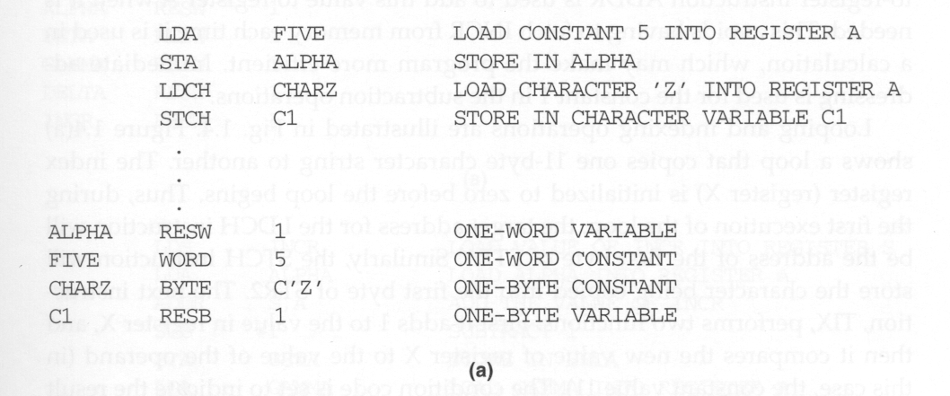
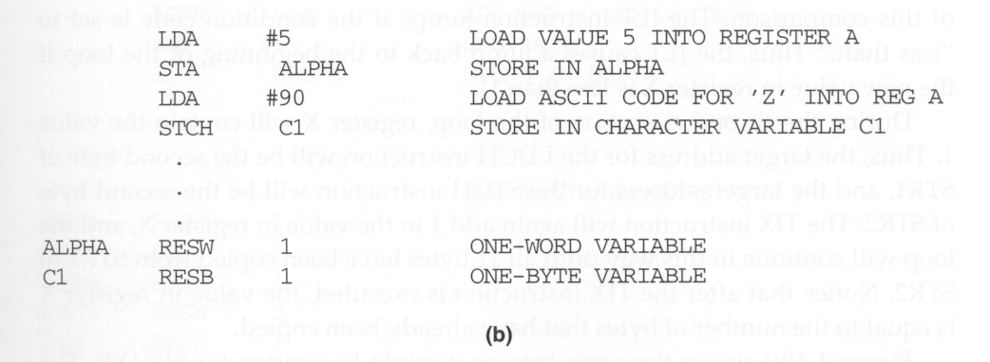
SIC Programming Examples (1) Data Movement
SIC
Assembler directives for defining storage
Address labels
SIC/XE
Immediate addressing makes program faster due to fewer memory reference

Slide 53
Sample data movement operations for SIC
CPU
A:
(ACC)
MEMORY
(word)
FIVE:
ALPHA:
(byte)
CHARZ:
C1:
(Z:character)
5
Z
5
5
Z
Z
LDA FIVE
STA ALPHA
LDCH CHARZ
STCH C1
.
ALPHA RESW 1
FIVE WORD 5
CHARZ BYTE C ’ Z ’
C1 RESB 1

Slide 54
Sample data movement operations for SIC/XE
CPU
A:
(ACC)
MEMORY
(word)
ALPHA:
(byte)
C1:
90
5
5
90->5A (ASCII CODE) =Z
LDA # 5
STA ALPHA
LDA # 90
STCH C1
.
ALPHA RESW 1
C1 RESB 1

Slide 55
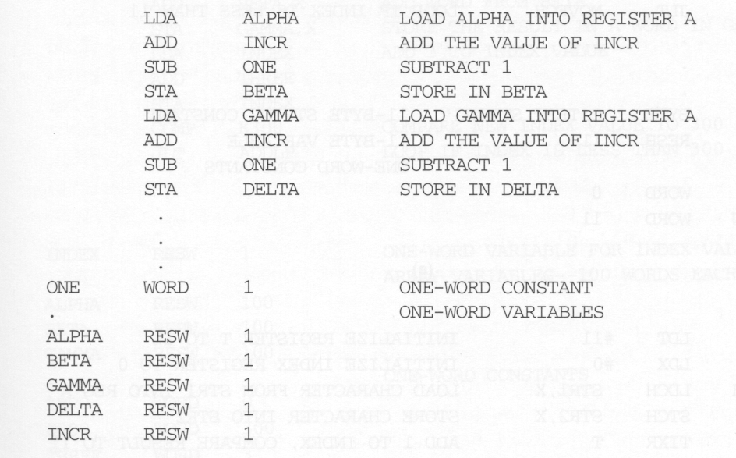
SIC Programming Examples (2) Arithmetic
SIC
BETA ← (ALPHA + INCR - 1)
DELTA ← (GAMMA + INCR - 1)

Slide 56
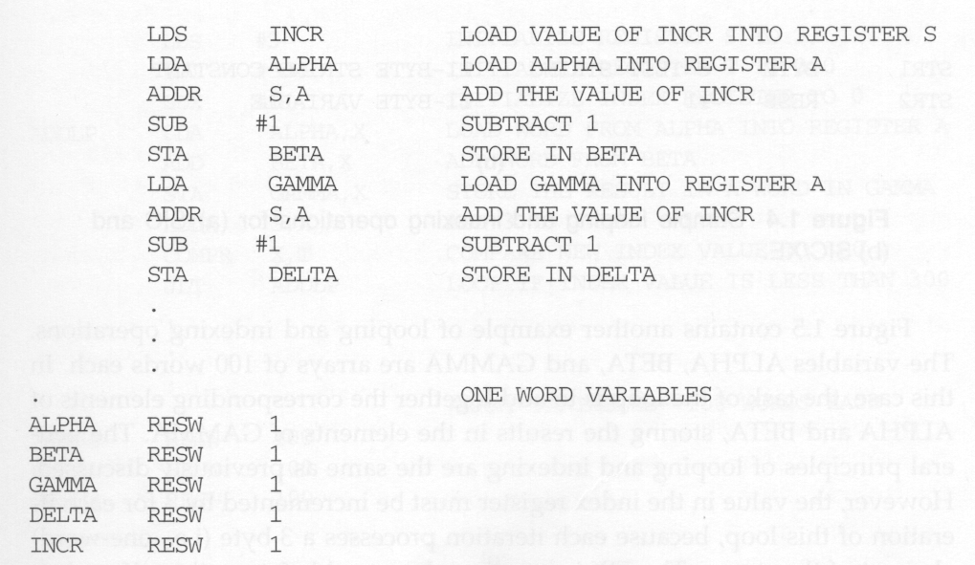
SIC Programming Examples (2) Arithmetic
SIC/XE
BETA ← (ALPHA + INCR - 1)
DELTA ← (GAMMA + INCR - 1)

Slide 57
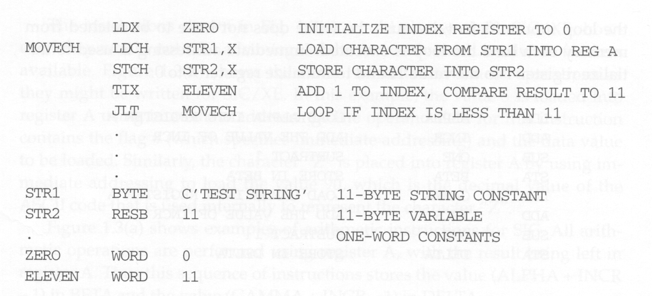
SIC Programming Examples (3) Looping and Indexing: part I
SIC
Copy one 11-byte string to another

Slide 58
Sample looping and indexing operations for (a)SIC
CPU
X:
PC
ACC
Status word:
MEMORY
(word)
ZERO:
ELEVEN:
(byte)
STR1:
STR2:
0 ->1
0
( test X=1 ,ELEVEN=11 )
0
( 1 < 11 )
MOVECH
11
T
T E S T S T R I N G
<
T
LDX ZERO
MOVECH LDCH STR1 , X
STCH STR2 , X
TIX ELEVEN
JLT MOVECH
.
STR1 BYTE C ’ TEST STRING ‘
STR2 RESB 11
.
ZERO WORD 0
ELEVEN WORD 11

Slide 59
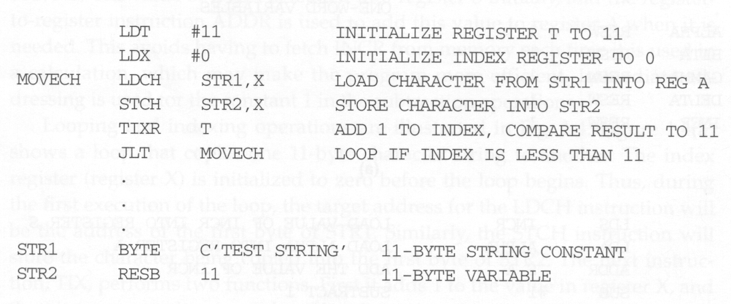
SIC Programming Examples (3) Looping and Indexing: part I
SIC/XE
Copy one 11-byte string to another

Slide 60
Sample looping and indexing operations for (b)SIC/XE
CPU
X:
T:
PC
ACC
Status word:
MEMORY
(byte)
STR1:
STR2:
0
0 ->1
( text X=1 ,T= 11 )
( 1 < 11 )
11
MOVECH
T
T E S T S T R I N G
<
T
LDT #11
LDX #0
MOVECH LDCH STR1 , X
STCH STR2 , X
TIXR T
JLT MOVECH
.
STR1 BYTE C ’ TEST STRING ‘
STR2 RESB 11

Slide 61
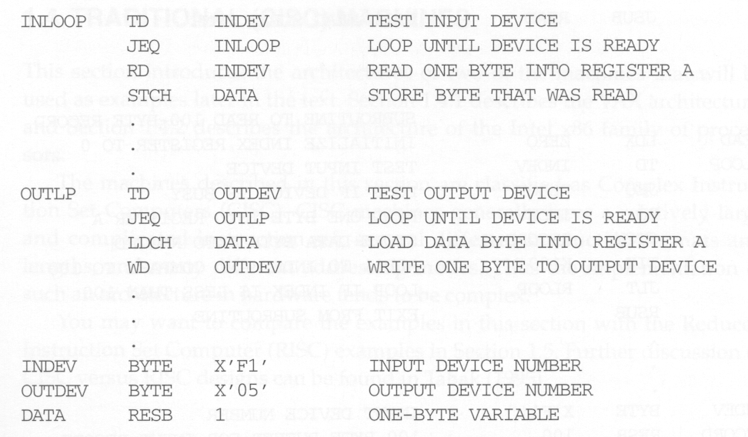
SIC Programming Examples (5) Input and Output
Read one byte from device F1
Write one byte to device 05

Slide 62
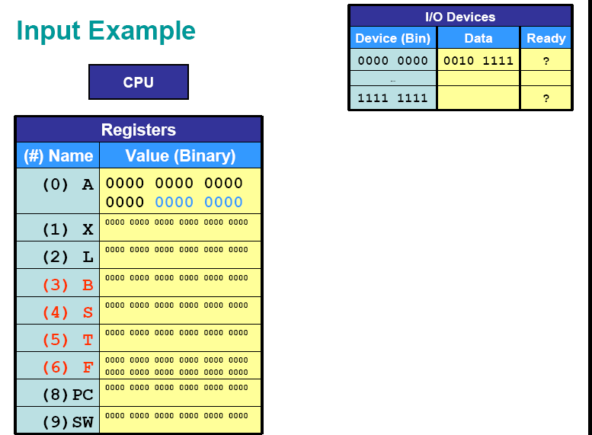

Slide 63
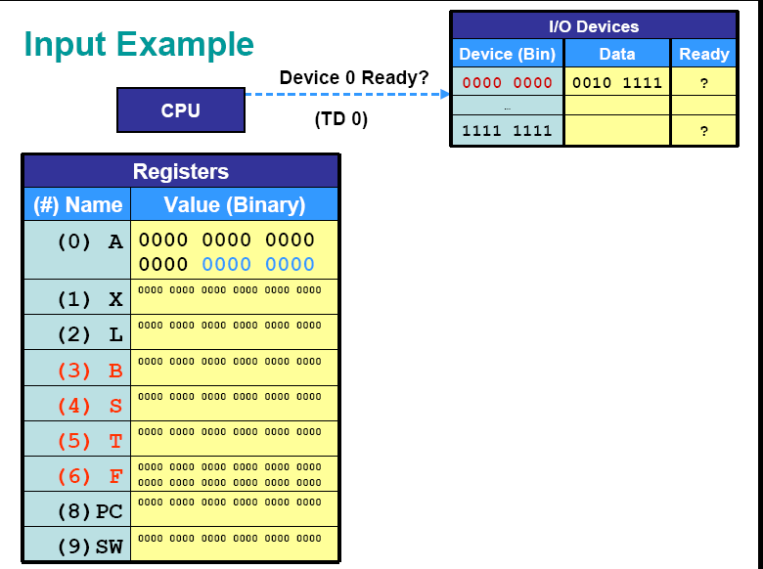

Slide 64
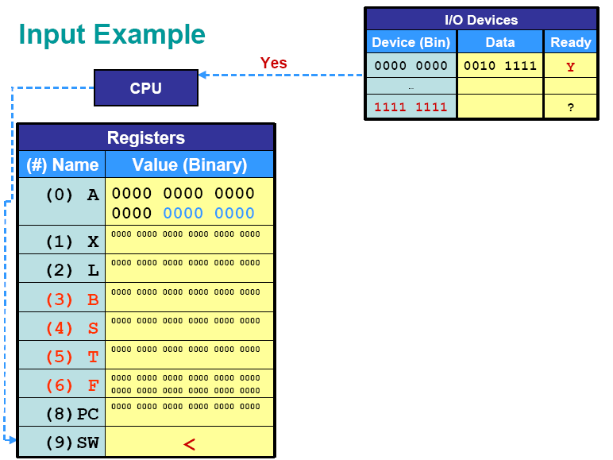

Slide 65
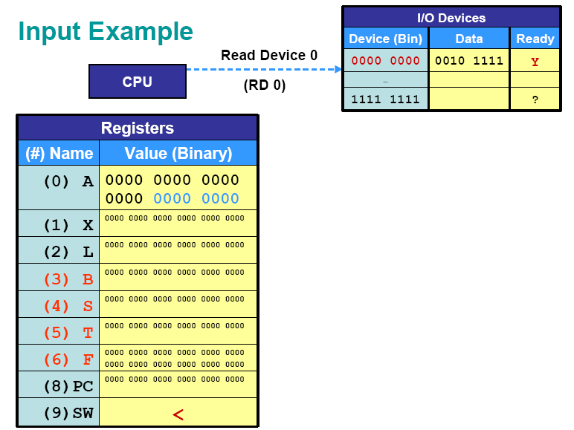

Slide 66
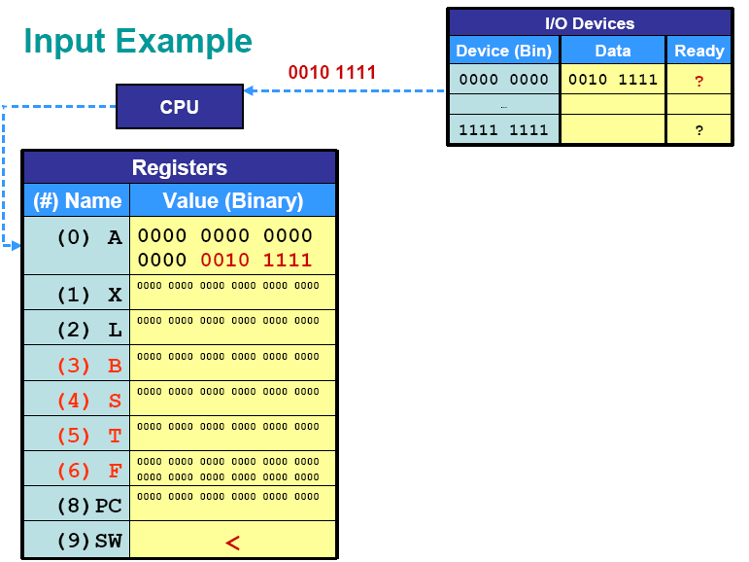

Slide 67
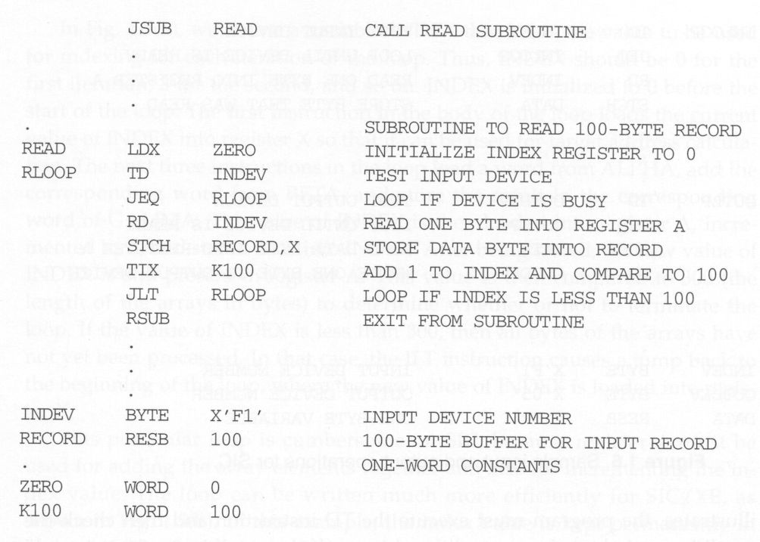
SIC Programming Examples (6) Subroutine Call
SIC
Read 100 bytes from device F1

Slide 68
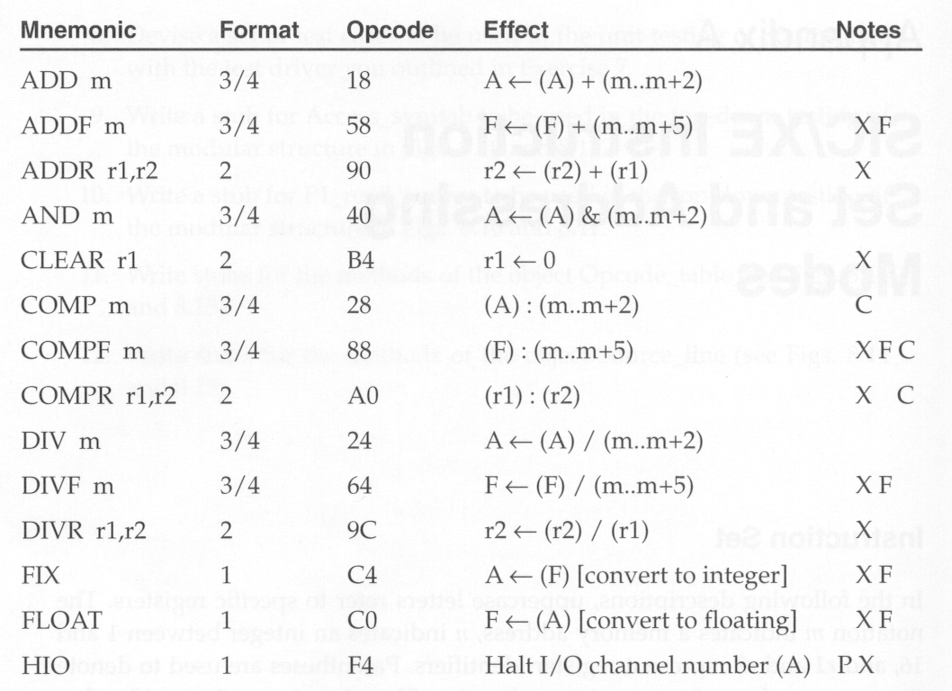
SIC/XE Instruction Set
X: only for XE
C: set CC
F: floating-point
P: privileged

Slide 69
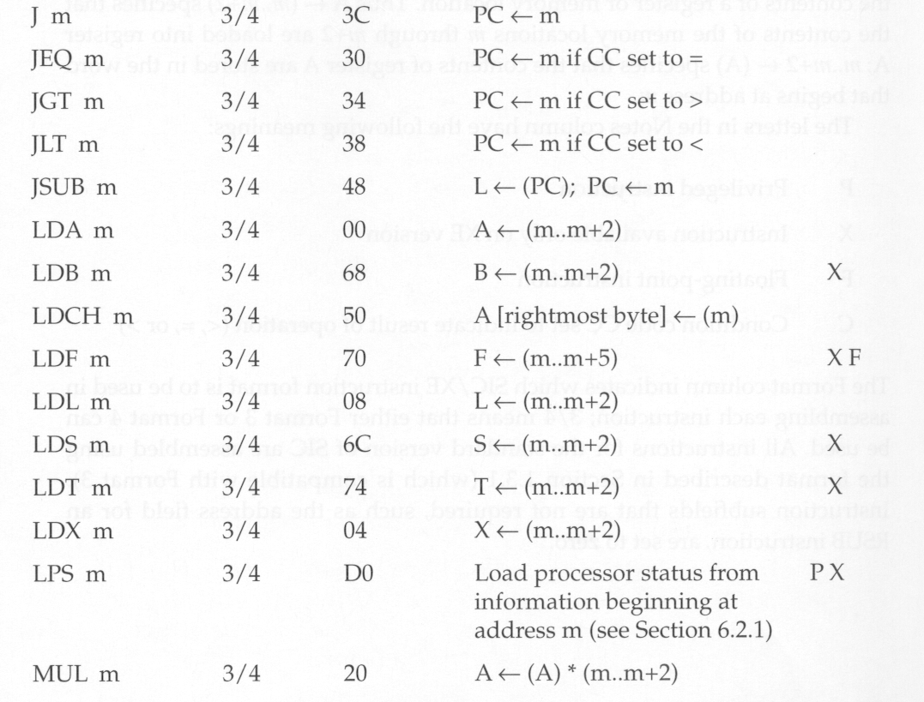
for interrupt

Slide 70
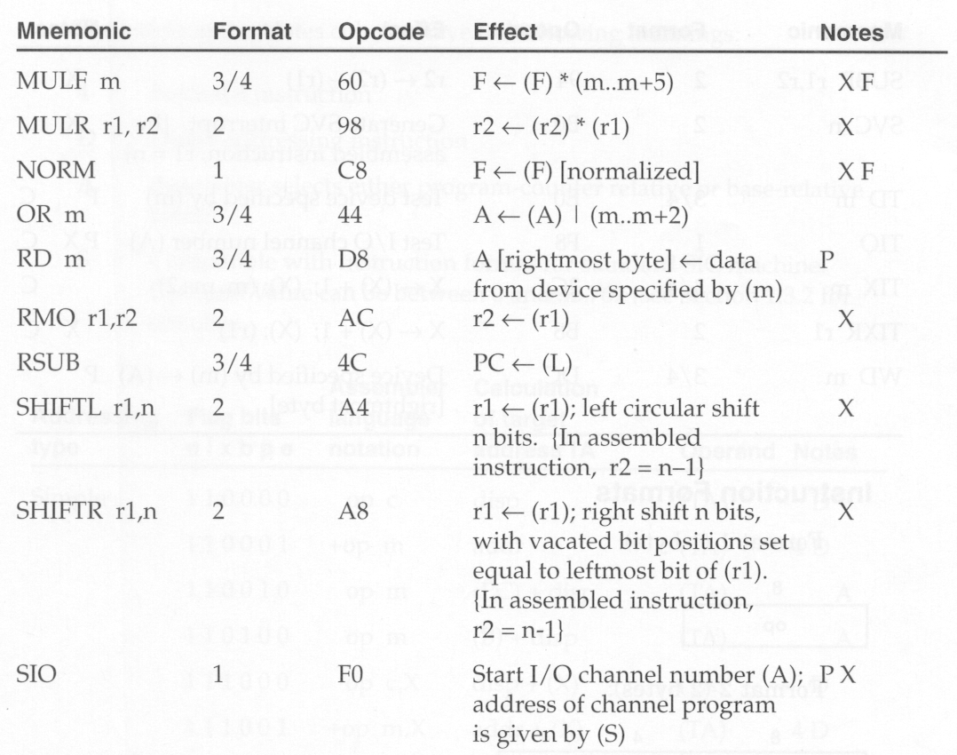

Slide 71
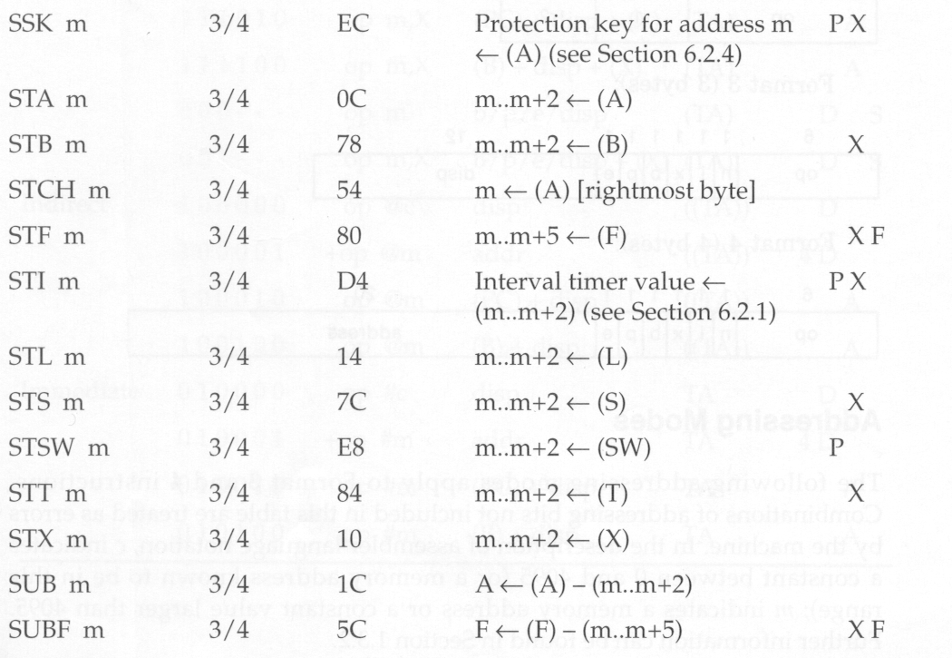
Set Storage Key for memory protection

Slide 72
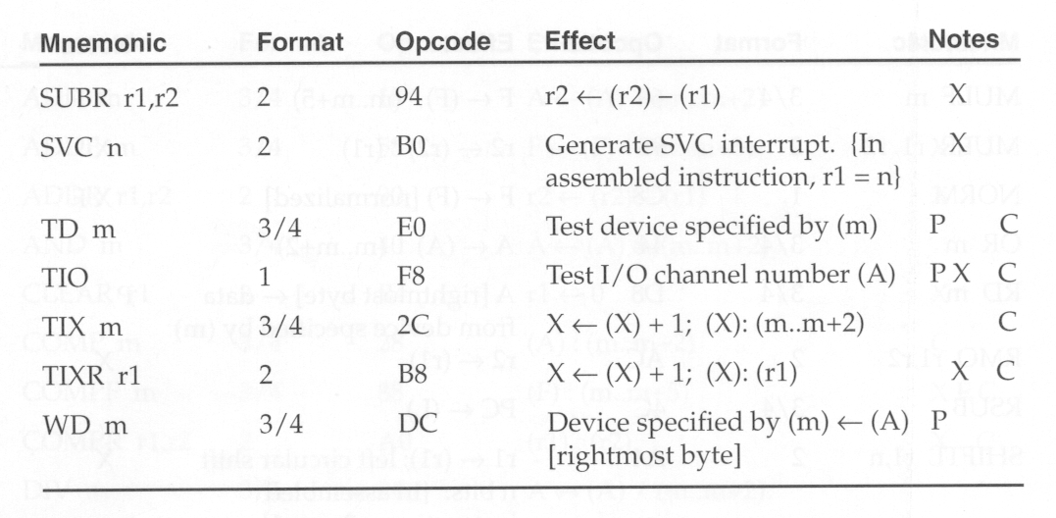

Slide 73
Two Categories
Complex Instruction Set Computers (CISC)
Relative large and complicated instruction set, more instruction formats, instruction lengths, and addressing modes
Hardware implementation is complex
Examples:
VAX
Intel x86
Reduced Instruction Set Computers (RISC)
Simplified design, faster and less expensive processor development, greater reliability, faster instruction execution times
Examples:
Sun SPARC
PowerPC

Slide 74
VAX Architecture
Memory: 232 bytes in virtual address space
consists of 8-bit bytes:
word: 2 bytes
longword: 4 bytes
quadword: 8 bytes
octaword: 16 bytes
can be divided into
System space (OS space)
Process space (defined separately for each process)

Slide 75
VAX Architecture
32-bit registers
16 general-purpose registers
R0-R11: no special functions
AP: argument pointer (address of arguments when making a procedure call)
FP: frame pointer (address of the stack frame when making a procedure call)
SP: stack pointer (top of stack in program’s process space)
PC: program counter
PSL: processor status longword
Control registers to support OS

Slide 76
VAX Architecture
Data formats
Characters: 8-bit ASCII codes
Integers:
2, 4, 8, 16-byte binary numbers
2’s complement for negative values
Floating-point numbers:
4 different floating-point data ranging in length from 4 to 16 bytes
Packed decimal data format
Each byte represents two decimal digits
Numeric format
To represent numeric values with one digit per byte
Queues and variable-length bit strings

Slide 77
VAX Architecture
Instruction formats
Variable-length instruction format
Each instruction consists of
OP code (1 or 2 bytes)
Up to 6 operand specifiers (depends on instruction)

Slide 78
VAX Architecture
Addressing modes
Register mode
Register deferred mode
Autoincrement and autodecrement modes
Base relative modes
PC relative modes
Index modes
Indirect modes
Immediate mode
etc

Slide 79
VAX Architecture
Instruction set
Mnemonics format (e.g., ADDW2, MULL3)
Prefix: type of operation
Suffix: data type of the operands
Modifier: number of operands involved

Slide 80
VAX Architecture
Input and output
Input and output on the vax are accomplished by I/O controller
Each controller device has a set of registers, which are assigned locations in the physical address space, called I/O space.

Slide 81
Pentium Pro Architecture
Memory:
consists of 8-bit bytes:
word: 2 bytes
double-word: 4 bytes
can be divided into a collection of segments with different sizes
Code, data, and stack segments
Each segment can be divided into pages

Slide 82
Pentium Pro Architecture
32-bit registers
8 general-purpose registers
EAX, EBX, ECX, EDX: data manipulation
ESI, EDI, EBP, ESP: addresses
EIP: pointer to the next instruction
FLAGS: processor status and calculation results
16-bit registers
CS, SS, DS, ES, FS, GS: segment registers
80-bit registers
8 80-bit registers for FPU

Slide 83
Pentium Pro Architecture
Data formats
Characters: 8-bit ASCII codes
Integers:
1, 2, 4-byte binary numbers (8-byte signed integers for FPU)
2’s complement for negative values
Floating-point numbers:
Single-precision: 32 bits (23)
Double-precision: 64 bits (52)
Extended-precision: 80 bits (63)

Slide 84
Pentium Pro Architecture
Instruction formats
Variable-length instruction format (1-10 bytes)
Each instruction consists of
OP code (1 or 2 bytes)
A number of bytes for operands and addressing modes

Slide 85
Pentium Pro Architecture
Addressing modes
Immediate mode
Register mode
Base relative mode
PC relative mode
Index mode
Direct mode
etc

Slide 86
Pentium Pro Architecture
Instruction set (>400 instructions)
0, 1, 2, or 3 operands
Register-to-register, register-to-memory, and memory-to-memory instructions
It include Special-purpose instructions , e.g., entering and leaving procedures, checking the bounds of an array

Slide 87
Pentium Pro Architecture
Input and output
I/O instructions that transfer one byte, word, or double-word from an I/O device into register EAX, or vice versa.

Slide 88
UltraSPARC Architecture
Memory: 264 bytes in virtual address space
consists of 8-bit bytes:
halfword: 2 bytes
word: 4 bytes
doubleword: 8 bytes
can be divided into pages
Virtual address is automatically translated into a physical address by the UltraSPARC Memory Management Unit.

Slide 89
UltraSPARC Architecture
The SPARC architecture includes a large register file that contains more than100 general-purpose registers.
Each procedure can access only 32 registers
A file of 64 double-precision floating-point registers fro FPU.
Program counter PC

Slide 90
UltraSPARC Architecture
Data formats
Characters: 8-bit ASCII codes
Integers:
1, 2, 4, 8-byte binary numbers
2’s complement for negative values
Floating-point numbers:
Single-precision: 32 bits
Double-precision: 64 bits
Quad-precision: 80 bits

Slide 91
UltraSPARC Architecture
Instruction formats
Fix-length instruction format (32 bits long)
Can speed the process of instruction fetching and decoding
3 basic instruction formats
Call instruction
Branch instruction
Register loads and stores, and three-operands arithmetic operations
Each instruction consists of
First 2 bits: identify formats
OP code
Operands

Slide 92
UltraSPARC Architecture
Addressing modes
Immediate mode
Register direct mode
PC relative mode only for branch instructions
Register indirect with displacement
Register indirect indexed

Slide 93
UltraSPARC Architecture
Instruction set (<100 instructions)
Register-to-register instructions
Load and store instructions (only instructions that access memory)
Instruction execution is pipelined.
Branch instructions are delayed branches

Slide 94
UltraSPARC Architecture
Input and output
In SPARC architecture communication with the input device is achieved through the memory.
The input and output operation is performed regular instructions, no special I/O instructions are needed.

Slide 95
PowerPC Architecture (1/8)
POWER stands for Performance Optimization with Enhanced RISC
History
IBM (1990) introduced POWER in 1990
IBM, Apple, and Motorola formed an alliance to develop PowerPC in 1991

Slide 96
PowerPC Architecture (2/8)
Memory
consists of 8-bit bytes:
Half word: 2 bytes
word: 4 bytes
Double word: 8 bytes
quad word : 16 bytes
virtual space 2⁶⁴ bytes
fixed-length segments, 256 MB
fixed-length pages, 4KB
MMU: virtual address -> physical address

Slide 97
PowerPC Architecture (3/8)
Registers
32 general-purpose registers, GPR0~GPR31
In Power PC each register is 64 bit long
Floating point computation are performed using FPU
Link Register (LR) and Count Register (CR) are used by some branch instructions
Machine Status Register (MSR)

Slide 98
PowerPC Architecture (4/8)
Data Formats
integers are 8-, 16-, 32-, 64-bit binary numbers
2’s complement is used for negative values
three different floating-point data formats
single-precision, 32 bits long (23 + 8 + 1)
double-precision, 64 bits long (52 + 11 + 1)
characters are stored using 8-bit ASCII codes

Slide 99
PowerPC Architecture (5/8)
Seven Instruction Formats
32 bits long
the first 6 bits identify specify the opcode
some instruction have an additional extended opcode
fixed-length makes decoding faster and simple than VAX and x86

Slide 100
PowerPC Architecture (6/8)
Addressing Modes
immediate mode, register direct mode
memory addressing
Mode Target address calculation
Register indirect TA=(register)
Register indirect with indexed TA=(register-1)+(register-2)
Register indirect with TA=(register)+displacement
immediate indexed
branch instruction
Mode Target address calculation
Absolute TA= actual address
Relative TA= current instruction address + displacement
Link Register TA= (LR)
Count Register TA= (CR)

Slide 101
PowerPC Architecture (7/8)
Instruction Set
200 machine instructions
more complex than most RISC machines
e.g. floating-point “multiply and add” instructions that take three input operands
pipelined execution
more sophisticated than SPARC

Slide 102
Cray T3E Architecture (1/8)
T3E is a Massively parallel processing system designed for application in Scientific computing.
T3E system contains a large number of processing element arranged in three dimensional network.
This network provide a path for transferring data between processor.
Each PE consist of a DEC alpha microprocessor.

Slide 103
Memory
Each processing element in the T3E has its own local memory with a capacity from 64MB to 2GB.
The memory within each processing element consist of 8 bit of byte.
word: 2 bytes
Long word: 4 bytes
quad word : 8 bytes

Slide 104
Cray T3E Architecture (3/8)
Registers
32 general-purpose registers, GPR0~GPR31
32 floating-point registers, F0~F31
F31 always contain the value zero
program counter PC
other status and control registers

Slide 105
Cray T3E Architecture (4/8)
Data Formats
two different types of floating-point data formats
one for compatibility with VAX
the other for IEEE standard formats
characters are stored using 8-bit ASCII codes

Slide 106
Cray T3E Architecture (5/8)
Five Basic Instruction Formats
32 bits long
the first 6 bits specify the opcode
some instruction have an additional function field

Slide 107
Cray T3E Architecture (6/8)
Addressing Modes
immediate mode,
register direct mode
PC-relative
Register indirect with displacement

Slide 108
Cray T3E Architecture (7/8)
Instruction Set
130 machine instructions
no byte or word load and store instructions

Slide 109
Input and output
The T3E system performs I/O through the I/O channel.

Slide 110
Comparison of CSIC and RSIC
CSIC | RISC
More number of instruction (100-250) | Less number of instructions(60-100)
Variable length instructions formats(16-64) bits per instructions | Fixed length instructions format
Limited number of general purpose register | More number of general purpose register (32-92)
It uses control memory | It does not uses control memory
Memory manipulation instructions are available | No memory manipulation instructions are available
Example : VAX,Pentium Pro. | Example:Ultra SPARC,Power PC,Cray T3E

Slide 111
Problem
1. Write a sequence of instructions for SIC/XE to divide BETA by GAMMA, setting ALPHA to The integer portion of the quotient and DELTA to the remainder. Use register-to-register Instructions to make the calculation as efficient as possible.

Slide 112
LDA BETA LDS GAMMA DIVR S, A STA ALPHA MULR S, A LDS BETA SUBR A, S STS DELTA : : ALPHA RESW 1 BETA RESW 1 GAMMA RESW 1 DELTA RESW 1

Slide 113
2. Write SIC instructions to swap the values of ALPHA and BETA.

Slide 114
LDA ALPHA STA TEMP LDA BETA STA ALPHA LDA TEMP STA BETA : : ALPHA RESW 1 BETA RESW 1 TEMP RESW 1

Slide 115
3.Suppose that ALPHA is an array of 100 words. Write a sequence of instructions for SIC/XE to set all 100 elements of the array to 0. Use immediate addressing and register-to-register instructions to make the process as efficient as
possible.

Slide 116
LDS #3 LDT #300 LDX #0 LOOP LDA #0 STA ALPHA, X ADDR S, X COMPR X, T JLT LOOP :: ALPHA RESW 100

